Slide 1
7.7
Arrays as Function Arguments

Slide 2
Arrays as Function Arguments
To pass an array to a function, just use the array name:
  showScores(tests);
To define a function that takes an array parameter, use empty [] for array argument:
  // function prototype
  void showScores(int []);
  // function header
  void showScores(int tests[])

Slide 3
Arrays as Function Arguments
When passing an array to a function, it is common to pass array size so that function knows how many elements to process:
  showScores(tests, ARRAY_SIZE);
Array size must also be reflected in prototype, header:
  // function prototype
  void showScores(int [], int);
  // function header
  void showScores(int tests[], int size)
7-<number>

Slide 4
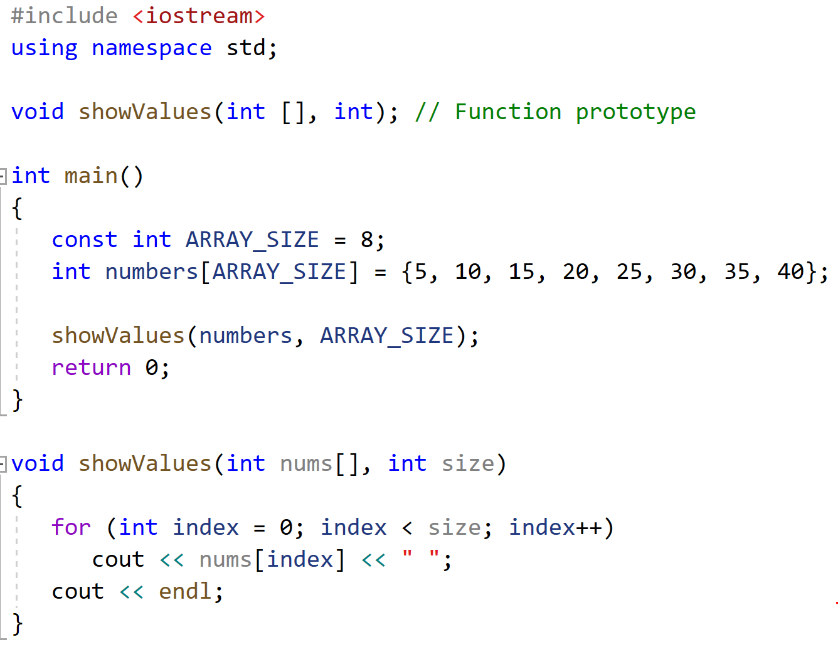
Passing an Array to a Function in Program 7-17

Slide 5
Modifying Arrays in Functions
Array names in functions are like reference variables – changes made to array in a function are reflected in actual array in calling function
Need to exercise caution that array is not inadvertently changed by a function

Slide 6
Using const Array Parameters
You can prevent a function from making changes to an array argument by using the const key word in the parameter declaration.
Example:
void showValues(const int nums[], int size)
{
for (int index = 0; index < size; index++)
cout << nums[index] << " ";
cout << endl;
}

Slide 7
Structured Binding Declarations and Array Arguments
If an array has been passed as an argument into a function, you cannot use a structured binding declaration in the receiving function to unpack the array.
This is because the compiler does not know the size of the array that might be passed into the parameter.
You can only use a structured binding declaration to unpack an array that has a known size.
  For example, one that has been defined in the same function as where the structured binding declaration is used.

Slide 8
7.8
Two-Dimensional Arrays

Slide 9
Two-Dimensional Arrays
Can define one array for multiple sets of data
Like a table in a spreadsheet
Use two size declarators in definition:
  const int ROWS = 4, COLS = 3;
  int exams[ROWS][COLS];
First declarator is number of rows; second is number of columns

Slide 10
Two-Dimensional Array Representation
const int ROWS = 4, COLS = 3; int exams[ROWS][COLS];
Use two subscripts to access element:
  exams[2][2] = 86;
columns
exams[0][0] | exams[0][1] | exams[0][2]
exams[1][0] | exams[1][1] | exams[1][2]
exams[2][0] | exams[2][1] | exams[2][2]
exams[3][0] | exams[3][1] | exams[3][2]
r
o
w
s

Slide 11
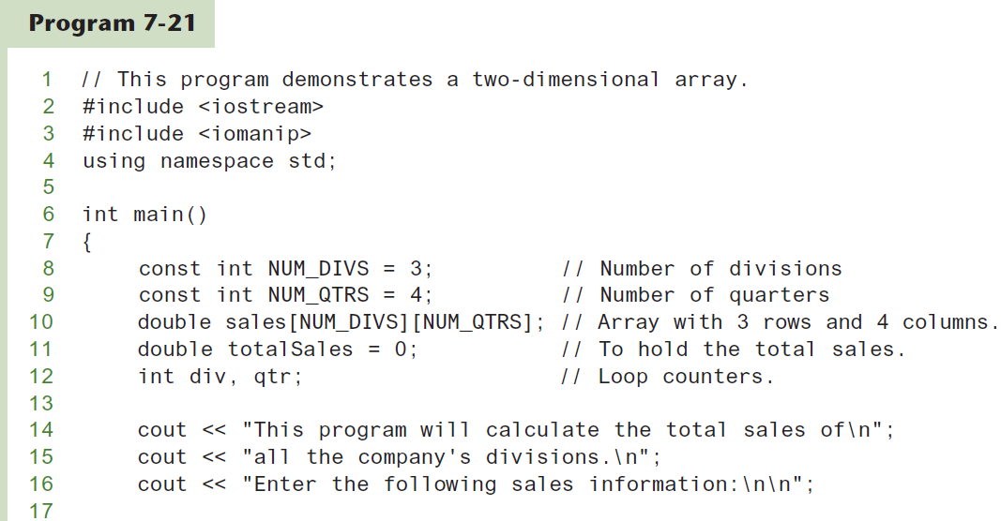
A Two-dimensional Array in Program 7-21
Continued…

Slide 12
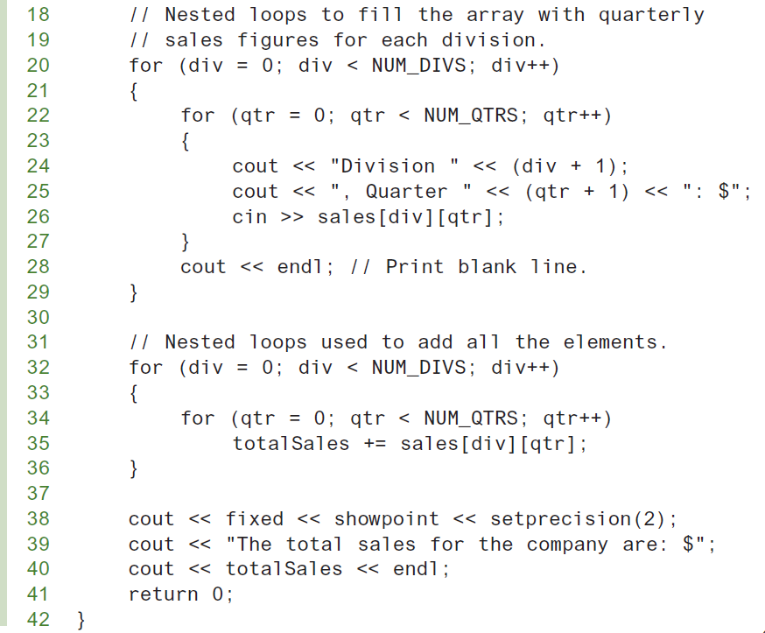
A Two-dimensional Array in Program 7-21

Slide 13
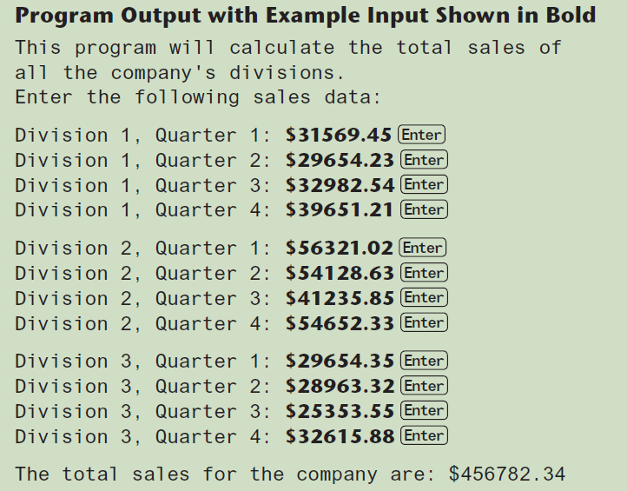
A Two-dimensional Array in Program 7-21

Slide 14
2D Array Initialization
Two-dimensional arrays are initialized row-by-row:
const int ROWS = 2, COLS = 2;
int exams[ROWS][COLS] = { {84, 78},
  {92, 97} };
Can omit inner { }, some initial values in a row – array elements without initial values will be set to 0 or NULL
84 | 78
92 | 97

Slide 15
Two-Dimensional Array as Parameter, Argument
Use array name as argument in function call:
  getExams(exams, 2);
Use empty [] for row, size declarator for column in prototype, header:
const int COLS = 2;
// Prototype
void getExams(int [][COLS], int);
// Header
void getExams(int exams[][COLS], int rows)

Slide 16
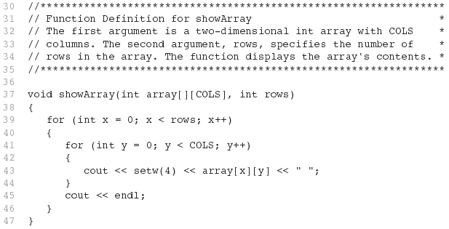
Example – The showArray Function from Program 7-22

Slide 17
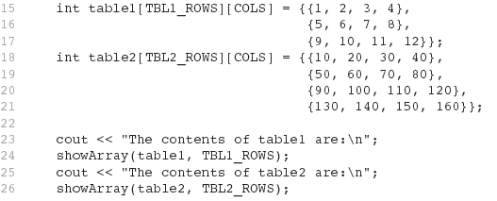
How showArray is Called

Slide 18
Summing All the Elements in a Two-Dimensional Array
Given the following definitions:
const int NUM_ROWS = 5; // Number of rows
const int NUM_COLS = 5; // Number of columns
int total = 0; // Accumulator
int numbers[NUM_ROWS][NUM_COLS] =
{{2, 7, 9, 6, 4},
{6, 1, 8, 9, 4},
{4, 3, 7, 2, 9},
{9, 9, 0, 3, 1},
{6, 2, 7, 4, 1}};

Slide 19
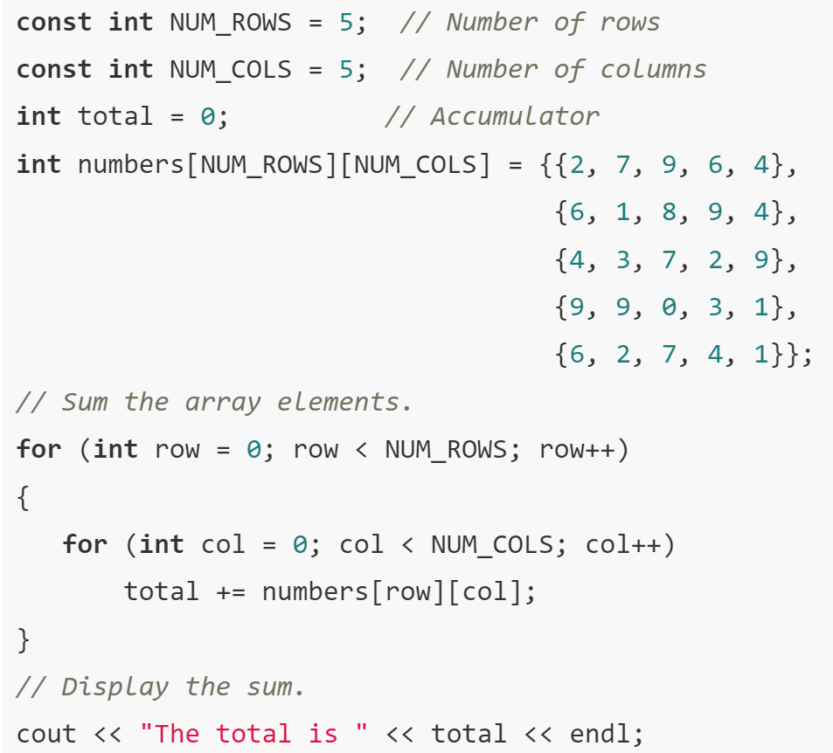

Slide 20
Summing the Rows of a Two-Dimensional Array
Given the following definitions:
const int NUM_STUDENTS = 3;
const int NUM_SCORES = 5;
double total; // Accumulator
double average; // To hold average scores
double scores[NUM_STUDENTS][NUM_SCORES] =
{{88, 97, 79, 86, 94},
{86, 91, 78, 79, 84},
{82, 73, 77, 82, 89}};

Slide 21
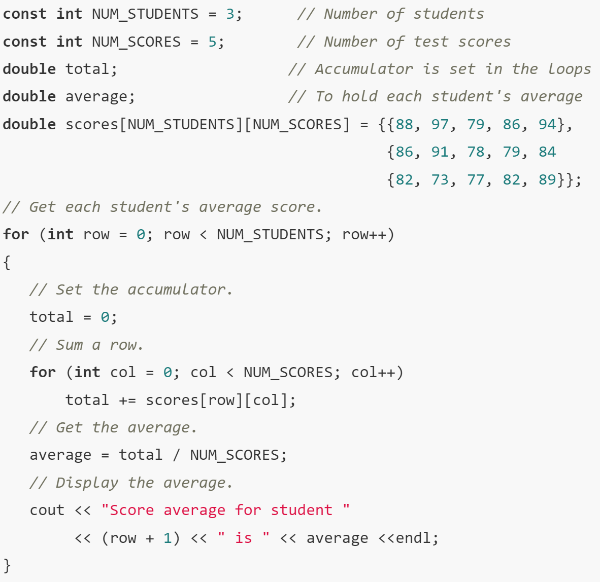

Slide 22
Summing the Columns of a Two-Dimensional Array
Given the following definitions:
const int NUM_STUDENTS = 3;
const int NUM_SCORES = 5;
double total; // Accumulator
double average; // To hold average scores
double scores[NUM_STUDENTS][NUM_SCORES] =
{{88, 97, 79, 86, 94},
{86, 91, 78, 79, 84},
{82, 73, 77, 82, 89}};

Slide 23
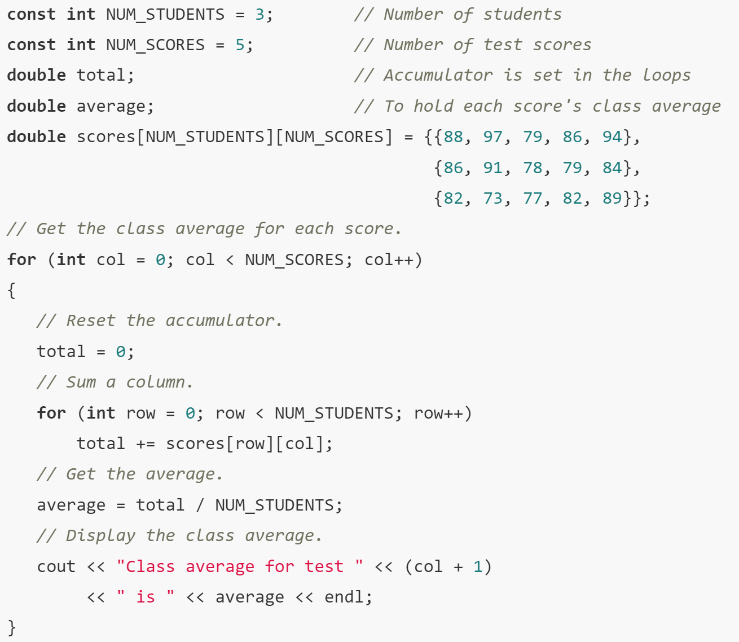

Slide 24
7.9
Arrays with Three or More Dimensions

Slide 25
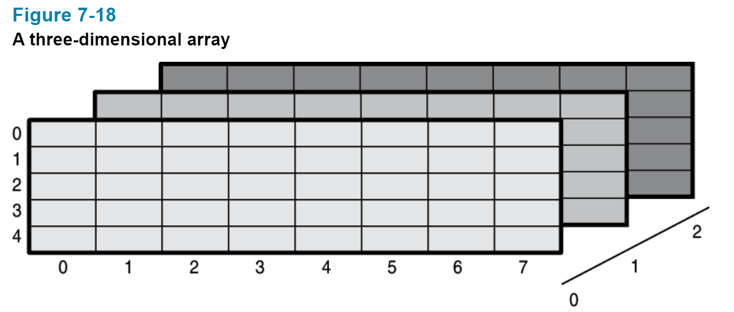
3D Arrray

Slide 26
Arrays with Three or More
Dimensions
Can define arrays with any number of dimensions:
  short rectSolid[2][3][5];
  double timeGrid[3][4][3][4];
When used as parameter, specify all but 1st dimension in prototype, heading:
  void getRectSolid(short [][3][5]);

Slide 27
7.11
Introduction to the STL vector

Slide 28
Introduction to the STL vector
A data type defined in the Standard Template Library (covered more in Chapter 17)
Can hold values of any type:
  vector<int> scores;
Automatically adds space as more is needed – no need to determine size at definition
Can use [] to access elements

Slide 29
Declaring Vectors
You must #include<vector>
Declare a vector to hold int element:
  vector<int> scores;
Declare a vector with initial size 30:
  vector<int> scores(30);
Declare a vector and initialize all elements to 0:
  vector<int> scores(30, 0);
Declare a vector initialized to size and contents of another vector:
  vector<int> finals(scores);

Slide 30
Adding Elements to a Vector
If you are using C++ 11, you can initialize a vector with a list of values:
vector<int> numbers { 10, 20, 30, 40 };
Use push_back member function to add element to a full array or to an array that had no defined size:
  scores.push_back(75);
Use size member function to determine size of a vector:
  howbig = scores.size();

Slide 31
Removing Vector Elements
Use pop_back member function to remove last element from vector:
  scores.pop_back();
To remove all contents of vector, use clear member function:
  scores.clear();
To determine if vector is empty, use empty member function:
  while (!scores.empty()) ...

Slide 32
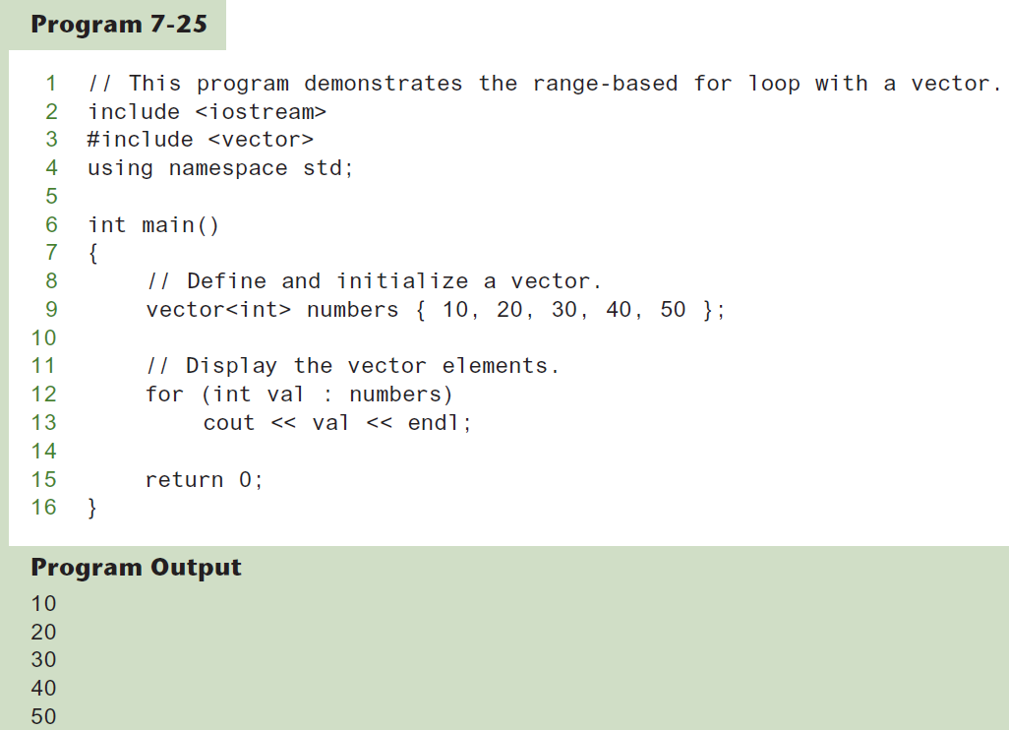
Using the Range-Based for Loop with a vector

Slide 33
Other Useful Member Functions
Member Function | Description | Example
at(i) | Returns the value of the element at position i in the vector | cout << vec1.at(i);
capacity() | Returns the maximum number of elements a vector can store without allocating more memory | maxElements = vec1.capacity();
reverse() | Reverse the order of the elements in a vector | vec1.reverse();
resize (n, val) | Resizes the vector so it contains n elements. If new elements are added, they are initialized to val. | vec1.resize(5, 0);
swap(vec2) | Exchange the contents of two vectors | vec1.swap(vec2);

